Slide 1
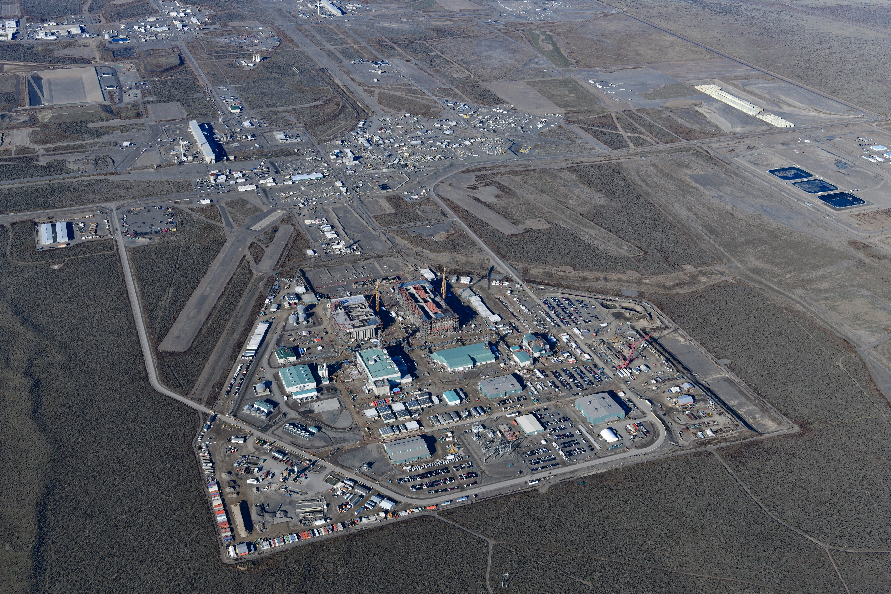
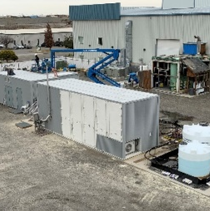
Integrated Disposal Facility
Accepts containers of vitrified LAW for disposal
AP Tank Farm
Feeds tank waste to cesium removal system and transfers feed to the LAW Facility
Liquid Effluent Retention and Effluent Treatment Facility
System providing storage and treatment for a variety of mixed secondary liquid waste
Tank-Side Cesium Removal (TSCR)
Removes solids and cesium from liquid tank waste to feed the LAW Facility
107
108
105
106
CESIUM TRANSPORT FROM TSCR
PRETREATED LAW
ION EXCHANGE COLUMN STORAGE PAD
Effluent Management Facility
Evaporates liquid effluent from the LAW Facility
LIQUID EFFLUENT FROM LAW FACILITY
Analytical Laboratory
Analyzes processed waste samples to ensure that glass produced by the LAW Facility meets all regulatory requirements and standards.
Low-Activity Waste (LAW) Facility
Mixes LAW feed with glass-forming materials; produces vitrified waste form in stainless steel containers for long-term storage
Legend
Untreated tank waste
Pretreated LAW
Liquid secondary effluent (from LAW Facility)
Cesium transport (from TSCR to ion exchange column)

